Slide 1

UTAH DEPARTMENT OF
AGRICLTURE AND FOOD
BRAND INSPECTION PROGRAM

Slide 2
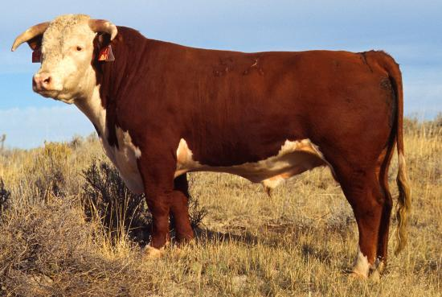
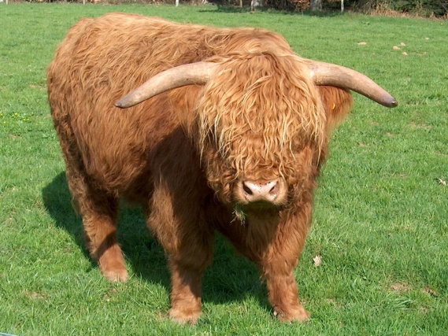
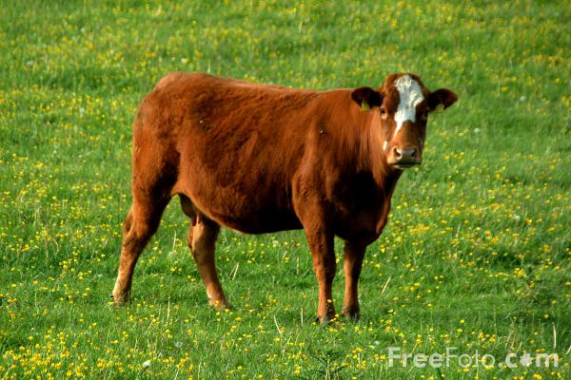
Certification Training
on
Verification of Ownership for
Farm Custom Slaughter Permittees and
Custom Exempt Meat Establishment that operate a slaughter floor

Slide 3
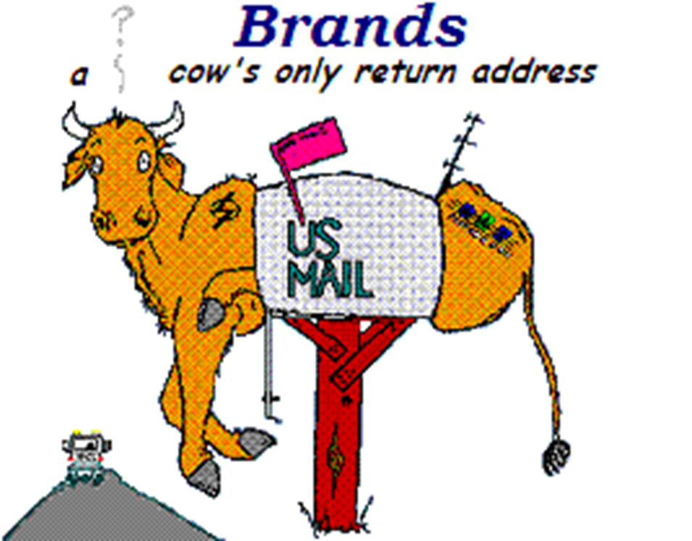

Slide 4
Utah Livestock Brand and Anti-Theft Act
4-24-304 Brand inspection required before slaughter Exceptions.
(1) Except as provided in Subsection (2), a brand inspection is required before any cattle, calves, horses, domesticated elk, or mules are slaughtered.
(2) A person may slaughter cattle, calves, horses, or mules for that person’s own use without a brand inspection if the requirements of Section 4-32-106 are met.

Slide 5
Utah Meat and Poultry Products Inspection and Licensing Act
4-32-106 Meat establishment license Slaughtering livestock except in licensed meat establishment prohibited. Exceptions
(1) A person may not, except in a licensed meat establishment, slaughter animals for human
consumption or assist other persons in the slaughter or processing of animals except as
otherwise provided in Subsection (2), or (3).

Slide 6
(2) A person who raises an animal or an employee of that person may slaughter an animal without
a farm custom slaughter license if:
(a) slaughtering or processing animals is not prohibited by local ordinance;
(b) any hide, viscera, blood, or other tissue is disposed of by removal to a rendering facility or
landfill or by burial, as allowed by law;

Slide 7
(c) the meat or poultry product derived from the slaughtered animal is consumed exclusively by
the person or the person's immediate family, regular employees of the person, or nonpaying
guests; and
(d) the meat or poultry product is marked "Not For Sale."
(3) Farm custom slaughter may be performed by a person who holds a valid farm custom slaughter
license.

Slide 8
(5) Any person who violates this section, except as otherwise provided in Subsection (6), is guilty
of a class C misdemeanor.
(6) Any person who offers for sale or sells any uninspected meat or poultry product is guilty of a
class B misdemeanor.

Slide 9
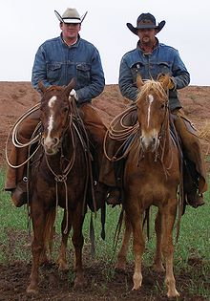
Verification of ownership by you as a Custom exempt slaughter facility or Farm custom slaughter licensee

Slide 10
R58. Agriculture and Food, Animal Industry. R58-26. Custom Exempt Slaughter Verification of Ownership.
R58-26-1. Authority and Purpose.
This rule is required by Section 4-24-304(2)(b) allows the department to authorize a custom exempt slaughter facility or farm custom slaughter licensee to verify ownership of cattle, calves, horses, or mules before slaughter for the owner’s use. Verification of ownership under this rule may be in addition to or equivalent to the brand inspection required in Section 4-24-304(1).

Slide 11
R58-26-4. Permit Requirements.
1) To obtain a permit to verify ownership of livestock, an eligible farm custom slaughter licensee or custom exempt slaughter facility shall:
a) possess a valid license pursuant to R58-11-3 or R58-13 in good standing with the department;
b) On line annual training arranged by the department to be educated about areas of compliance required under the permit;
c) sign an acknowledgement agreeing to abide by state law and this rule; and
d) pay a fee to the department, as set forth in the fee schedule approved by the legislature.

Slide 12
2) A permittee subject to this rule shall:
a) comply with all state laws and rules pertaining to the operation of a farm custom slaughter permit;
b) verify ownership of an animal for farm custom slaughter purposes only;
c) collect the following fees:
i) a minimum cattle inspection certificate fee per owner or producer;
ii) a fee per head for beef promotion;
iii) a fee per head for predator control; and
iv) a fee per farm custom slaughter “Not for Sale” tag;

Slide 13
d) remit all fees collected to the department monthly by the tenth day of the month; and
e) complete a farm custom slaughter report that includes the following information:
i) the owner’s contact information, including name, address, and phone number;
ii) the number of cattle slaughtered;
iii) the number of inspection certificates and “Not for Sale” tag numbers issued; and
iv) each fee collected; and
f) submit the report, along with the original copy of each inspection certificate issued and “Not for Sale” tag receipt, to the department by the tenth day of each month.

Slide 14
2) For the purpose of this rule, a document or fee is remitted or submitted to the department by the tenth day of the month if it is physically received in the office of the department by the tenth day of each month.
3) A permittee that follows the requirements of R58-26-4 subsections a-f shall be designated by the department as an official agent to verify ownership of the animal for farm custom slaughter purposes only.

Slide 15
R58-26-8. Violation.
1) It is a violation of this rule if a permittee:
a) fails to submit a farm custom slaughter report, required documentation, and fees collected pursuant to R58-26-4(2)(c) by the tenth of each month;
b) does not perform verification of ownership to the standards established by the department in R58-26-7(2); including:
c) if the permittee fails to conduct the verification of ownership during daylight hours;
d) if the permittee does not record the number, sex, breed, and brand or mark on each animal inspected together with the owner’s name;

Slide 16
e) if the permittee does not contact the department if they are unsure of or cannot verify ownership of an animal presented for custom exempt slaughter; or
f) if the permittee accepts breed papers alone as proof of ownership.
2) If a permittee is found in violation of this rule:
a) the department will verify ownership for farm custom slaughter purposes;
b) the permittee shall have their permit withdrawn;
c) the department may revoke or suspend the permittee’s farm custom slaughter license or custom exempt slaughter facility license; and
d) the permittee may be subject to a penalty.

Slide 17
Violation Examples
Not verify ownership
The Department of Agriculture and Food, not receiving your monthly reports by the 10th
Includes:
Monthly recap sheet
Blue verification ownership certificates
Not For Sale Tag receipt
Check with a correct amount
Note! All reports must be filled out in full and correctly

Slide 18
R58-26-8. Penalties.
1) The department shall use a penalty matrix to determine an appropriate penalty for violation of this rule.
2) The department shall calculate each penalty based on the level of violation and the adverse effect or potential adverse effect at the time of the incident giving rise to the violation.
3) The median penalty shall be assessed unless a proportionate adjustment is warranted or there is an aggravating or mitigating factor present.
4) The department may consider a circumstance enhancing or reducing the penalty based on the seriousness of the violation.

Slide 19
5) An aggravating and mitigating factor could include the following:
a) the number of separate alleged violations contained within a single notice of intent;
b) the magnitude of the harm, or potential harm, including quantity or degree caused by the violation;
c) the similarity of the current alleged violation to a violation committed by the permittee previously; or
d) the extent to which the alleged violation is part of a pattern of the same or substantially similar conduct.
6) The department will review past violation trends annually, and update the penalty matrix based on compliance history.
7) A copy of the penalty matrix will be made available from the department upon request.

Slide 20
VERIFICATION OF OWNERSHIP
Verification of ownership means an examination of livestock by a eligible farm custom slaughter licensee or custom exempt slaughter facility that hold a permit. Brands, tags, earmarks, wattles, color, sex, age, or any other form of identification to establish ownership or to prevent theft of livestock. To successfully accomplished a verification of ownership, you must carefully examine each applicable area on each animal presented for slaughter.

Slide 21
While there is no substitute for actual experience in verification of ownership there are certain things you can do that will help.
Become familiar with the members of the livestock industry in your area.
Learn what type of livestock each one raises.
Ask questions and observe what brands or other forms of identification ranchers use.
Expand knowledge of the area, where people live and where they run livestock.

Slide 22
PROOF OF OWNERSHIP
Cattle
Brand Inspection Certificate
Issued by the Brand Inspector
Recorded Brand, Earmark on animals and/or
Brand Card
Auction Invoice

Slide 23
BRAND CARD
State Utah Cattle/Horse
Department of Agriculture & Food
Certificate of Registration S+S
1-0571-27
Mr. Smith Right Hip
123South 456 West
Taylorsville, UT 12345
Expires ##/##/####

Slide 24



Utah Livestock Brand Book
Utah
Utah
LIVESTOCK
BRAND
BOOK

Slide 25
Auction Invoice

Slide 26
NOT FOR SALE TAG FOR FARM CUSTOM SLAUGHTER LICENSEES

Slide 27
BACK SIDE OF THE NOT FOR SALE TAG

Slide 28
BRANDS
A distinctive design or mark, made or applied to the hide of the animals by use of a hot iron, freeze brand, or paint.
Brands are composed of capital letters of the alphabet, numerals, pictures, and character.
Like a book, there are three accepted rules to reading brands.
Left to right (Straight away)
Top to bottom (Stacked)
Outside to Inside.

Slide 29










BRANDS EXAMPLES
(Straight Away)
(Lazy S)
(Combined A B)
(Stacked SM)
(Circle B)
(Hanging e z)
(Reverse B)
(Flying U)
(Open A)
(Picture)

Slide 30
BRAND LOCATION
Right Hip
Right Ribs
Right Shoulder
Right Neck
Left Hip
Left Rib
Left Shoulder
Left Neck
Lip
Face
Rump
Withers
Center Back

Slide 31
R58-11-5. Slaughter Procedures of Livestock
(1) Slaughter Area
(a) Slaughtering shall not take place under adverse conditions (such as blowing dirt, dust or in mud).
(b) If a slaughter area is used for repeated kills, the area should be maintained to prevent blood from collecting, running off on to adjacent property, or contaminating water sources.

Slide 32
(c) Hides, viscera, blood, pounch material, and all tissues must be removed and disposed at a rendering facility, landfill, composting or by burial as allowed by law.
(2) Humane Slaughter - Animals shall be rendered insensible to pain by a single blow, or gun shot or electrical shock or other means that is instantaneous and effective before being shackled, hoisted, thrown, cast or cut.
(3) Hoisting and Bleeding - Animals shall be hoisted and bled as soon after stunning as possible to utilize post-stunning heart action and to obtain complete bleeding. Carcasses shall be moved away from the bleeding area for skinning and butchering.

Slide 33
(4) Skinning - Carcass and head skin must be handled without neck tissue contamination. This may be done by leaving the ears on the hide and tying the head skin. Feet must be removed before carcass is otherwise cut. Except for skinning and starting skinning procedures, skin should be cut from inside outward to prevent carcass contamination with cut hair. Hair side of hide should be carefully rolled or reflected away from carcass during skinning. When carcass is moved from skinning bed, caution should be taken to prevent exposed parts from coming in contact with adulterating surfaces.

Slide 34
(5) Evisceration - Before evisceration, rectum shall be tied to include bladder neck and to prevent urine and fecal leakage. Care should also be taken while opening abdominal cavities to prevent carcass and/or viscera contamination.
(6) Carcass washing - Hair, dirt and other accidental contamination should be trimmed prior to washing. Washing should proceed from the carcass top downward to move away any possible contaminants from clean areas.

Slide 35
R58-11-6. Identification and Records
(1) Livestock Identification - Pursuant to requirements of Section 4-24-13, it shall be unlawful for any license holder to slaughter livestock which do not have a Brand Inspection Certificate or Farm Custom Slaughter Tag filled out at time of slaughter.
(a) Animal owners must have a Brand Inspection Certificate for livestock intended to be farm custom slaughtered, issued by a Department Brand Inspector prior to slaughter, paying the legal brand inspection fee and beef promotion fee. This will be accomplished by the animal owner contacting a Department Brand Inspector and obtaining a Brand Inspection Certificate (Custom Slaughter-Release Permit).

Slide 36
(2) Records.
(a) The Custom Slaughter-Release Permit or Farm Custom Slaughter Tag will record the following information:
(i) An affidavit with a statement that shall read "I hereby certify ownership of this animal to be slaughtered by (name). I fully understand that having my animal farm custom slaughtered means my animal will not receive meat inspection and is for my use, the use of my immediate family, non-paying guests, or full-time employees. The carcass will be stamped "NOT FOR SALE" and will not be sold." This statement must be signed by the owner or designee.

Slide 37
R58-11-6. Identification and Records
(ii) In addition to this affidavit, the following information will be recorded:
(A) date;
(B) owner's name, address and telephone number;
(C) animal description including brands and marks;
(D) Farm Custom Slaughter tag number.
(b) The Farm Custom Slaughter tag must record the following information:

Slide 38
(i) date;
(ii) owner's name, address and telephone number;
(iii) location of slaughter;
(iv) name of licensee;
(v) licensee permit number; and
(vi) carcass destination.
(c) Prior to slaughter the licensee shall:

Slide 39
(i) Prepare the Farm Custom Slaughter tag with complete and accurate information;
(A) One tag shall stay in the license holder's file for at least one year.
(B) One tag plus a copy of the Farm Custom Slaughter-Release Permit shall be sent into the Department by the 10th of each month for the preceding month's slaughter by the licensee.

Slide 40
(C) After slaughter, all carcasses must be stamped "NOT FOR SALE" on each quarter with letters at least 3/8" in height; further, a Farm Custom Slaughter "NOT FOR SALE" tag must be affixed to each quarter of beef and each half of pork and sheep.
(D) Hide Purchase - Licensee receiving hides for slaughtering services must obtain a copy of the Custom Slaughter-Release Permit to record transfer of ownership as required by Section 4-24-18.

Slide 41
R58-11-9. Enforcement Procedures
(1) Livestock and Poultry Slaughtering License:
(a) It shall be unlawful for any person to slaughter or assist in slaughtering livestock and poultry as a business outside of a licensed slaughterhouse unless he holds a valid Farm Custom Slaughtering License issued to him by the Department.
(b) Only persons who comply with the Utah Meat and Poultry Products Inspection and Licensing Act and Rules pursuant thereto, and the Utah Livestock Brand and Anti-Theft Act shall be entitled to receive and retain a license.

Slide 42
(c) License may be renewed annually and shall expire on the 31st of December of each year.
(2) Suspension of license - license may be suspended whenever:
(a) The Department has reason to believe that an eminent public health hazard exists;
(b) Insanitary conditions are such that carcasses would be rendered adulterated and or contaminated.
(c) The license holder has interfered with the Department in the performance of its duties;

Slide 43
d) The licensee violates the Utah Meat and Poultry Products Inspection and Licensing Act or the Utah Livestock Brand and Anti-Theft Act or rules pursuant to these acts.
(3) The department may, in accordance with the 9 CFR part 500 suspend or terminate any exemption with respect to any person whenever the department finds that such actions will aid in effectuating the purposes of the Act.

Slide 44
Failure to comply with the conditions of the exemption including bot not limited to failure to process poultry and poultry products under clean and sanitary condition may result in termination of an exemption, in addition to other Penalties consistent with 9 CFR 318.13.
(4) Warning letter - In instances where a violation may have occurred a warning letter may be sent to the licensee which specifies the violations and affords the holder a reasonable opportunity to correct them.

Slide 45
(5) Hearings - Whenever a licensee has been given notice by the Department that suspected violations may have occurred or when a license is suspended he may have an opportunity for a hearing to state his views before the Department.
(6) Reinstatement of Suspended Permit - Any person whose license has been suspended may make application for the purpose of reinstatement of the license. The Department may then re-evaluate the applicant and conditions; if the applicant has demonstrated to the Department that he will comply with the rules, the license may be reinstated.

Slide 46
(7) Detainment or Embargo - Any meat found in a food establishment which does not have the proper identification or any uninspected meat slaughtered by a licensee which does not meet the requirements of these rules may be detained or embargoed.
(8) Condemnation - Meat which is determined to be unfit for human consumption may be denatured or destroyed.

Slide 47
CATTLE
NON-AMBULATOY DISABLED CATTLE
9CFR 309.2(b) state that non-ambulatory disabled livestock, including cattle are livestock that cannot rise from a recumbent position or that cannot walk, including, but not limited to, those with broken appendages, severed tendons or ligament, nerve paralysis, fractured vertebral column or metabolic conditions.

Slide 48
9 CFR 309.3(e) state that non-ambulatory
disabled cattle shall be condemned. Consequently, these cattle, which may be on the premise housing the slaughter establishment, cannot enter the slaughter establishment.
Non-ambulatory disabled cattle are considered unfit for use as human food. This determination is derived from Tile 1, Section 1(m)(3) of the Federal Meat Inspection Act.

Slide 49
SPECIFIED RISK MATERIAS (SRM)
9 CFR 310.22
(a) continues to define “SRMs” as:
(1) The brain, skull, eye, trigrminal ganglia, spinal cord, vertebral column (excluding the vertebrae of the tail, the transverse processes of the thoracic and lumbar vertebrae, and the wings of the sacrum), and dorsal root ganglia (DRG) of cattle 30 months of age and older and
(2) The tonsils and the distal lieum from all
cattle.

Slide 50
If you have any questions on this training, please contact Noel McSpadden
Meat & Poultry Inspection
Program Manager
Phone: 801-520-4313
Email: nmcspaddenjr@utah.gov

